Slide 1
Bank Churn Analysis
A Data-Driven Approach to Understand Customer Retention.

Slide 2
Project Objective
Identify why customers leave the bank by analyzing churn patterns.
Use Excel for data cleaning, SQL for analysis, and Power BI for visual storytelling.
Analyze churn based on key factors such as age, tenure, activity status, and credit card usage.
Help the business take informed actions to improve customer retention and reduce churn.

Slide 3
Tools & Workflow
SQL - Analysis
Power BI – Dashboard & insights
Excel - Cleaning
Raw Data

Slide 4
Excel Data Cleaning
Removed blank rows and unnecessary columns
Checked for and handled missing values
Standardized column names for consistency
Converted data types where necessary (e.g., dates, numbers)
Removed duplicates to ensure data accuracy
Saved cleaned data as CSV for further analysis

Slide 5
SQL Analysis
Used MySQL Workbench for querying the cleaned dataset
Performed descriptive analysis to understand churn patterns
Analyzed churn based on factors like:
. Customer status
. Age group
. Tenure
. Credit card usage
Wrote SQL queries to calculate:
. Total customers
. Churn rate
. Count by categories (e.g., active/inactive, age groups)

Slide 6
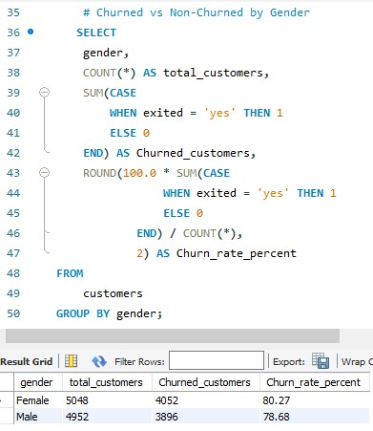
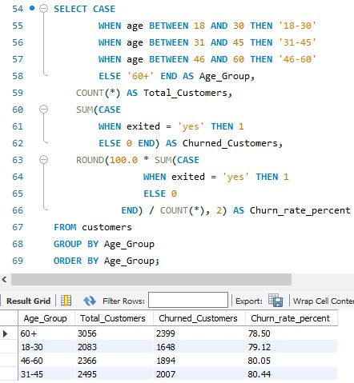
Churn by Gender
Churn by Age Group
Analyzes churn distribution across male and female customers.
Highlights which age groups have the highest churn rates.

Slide 7
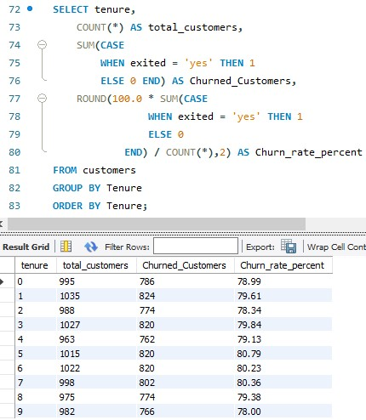
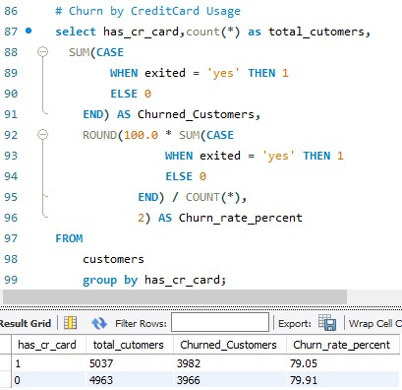
Churn by Tenure
Churn by Credit Card Usage
Shows churn patterns in relation to customer tenure with the bank.
Compares churn rates between customers with and without a credit card.

Slide 8
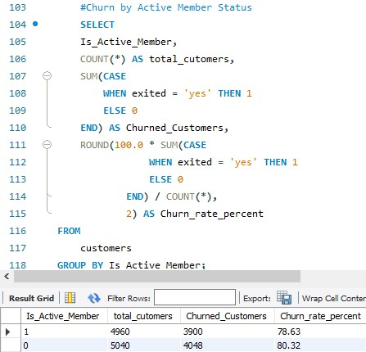
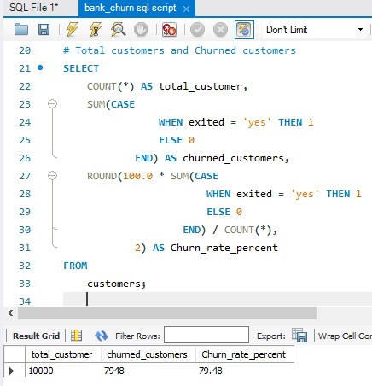
Overall Churn Rate
Churn by Activity Status
Analyzes churn based on whether the customer is an active member.
Calculates the percentage of customers who have churned from the total.

Slide 9
Power BI Visualization
Imported SQL-cleaned data into Power BI
Created interactive dashboards to visualize churn insights
Key visualizations:
. Churned Customers by Status
. Churn by Age Group
. Churn by Tenure
. Churn by Credit Card Usage
. Churn by Active Member & Gender
Used filters and slicers for dynamic exploration
Focused on presenting actionable insights

Slide 10
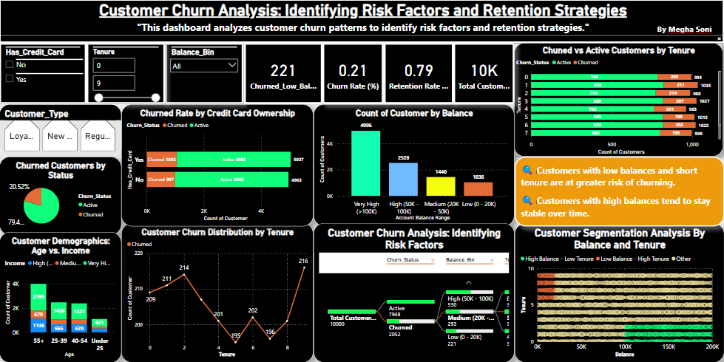
Bank Churn Analysis Dashboard

Slide 11
Key Insights & Findings
Based on the SQL Analysis & Dashboard on the previous slide
Churn rate is around 20%
Highest churn in customers aged 30–45
Low tenure customers (0–3 years) churn more
Inactive members are more likely to churn
Churn is higher among credit card users
Slightly more churn among female customers

Slide 12
Recommendations to Reduce Customer Churn
Target High-Risk Age Groups : Focus on customers aged 30–40 with personalized retention campaigns
Strengthen Early Engagement : Offer welcome bonuses, rewards, or better onboarding to new customers with low tenure
Encourage Credit Card Adoption : Promote benefits of credit cards to customers who don’t use them
Re-engage Inactive Members : Launch campaigns (emails, calls, offers) to bring back inactive users
Gender-Specific Offers: If churn is higher among a gender, design personalized offers to improve retention
Monitor and Act Promptly : Use churn prediction to identify and reach out to at-risk customers early

Slide 13
Conclusion :
This project analyzed customer churn using SQL, Excel, and Power BI
Key churn factors were identified: age group, tenure, credit card usage, and activity status
Recommendations were made to help the bank retain customers and reduce churn
Thank you for viewing my project. I’m happy to answer any questions or discuss further insights.

